Slide 1
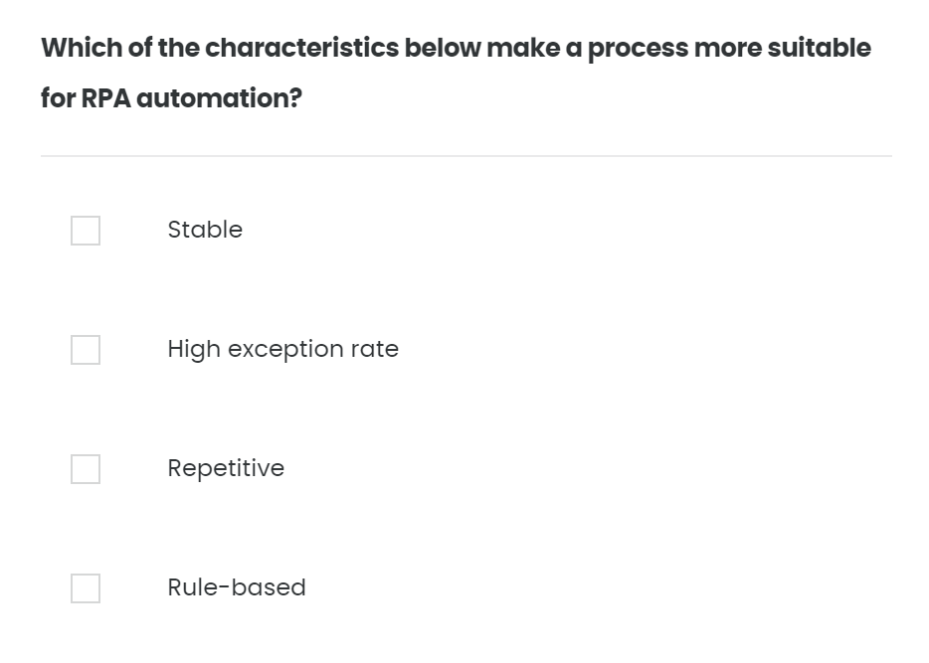
Quiz – 01/10

Slide 2
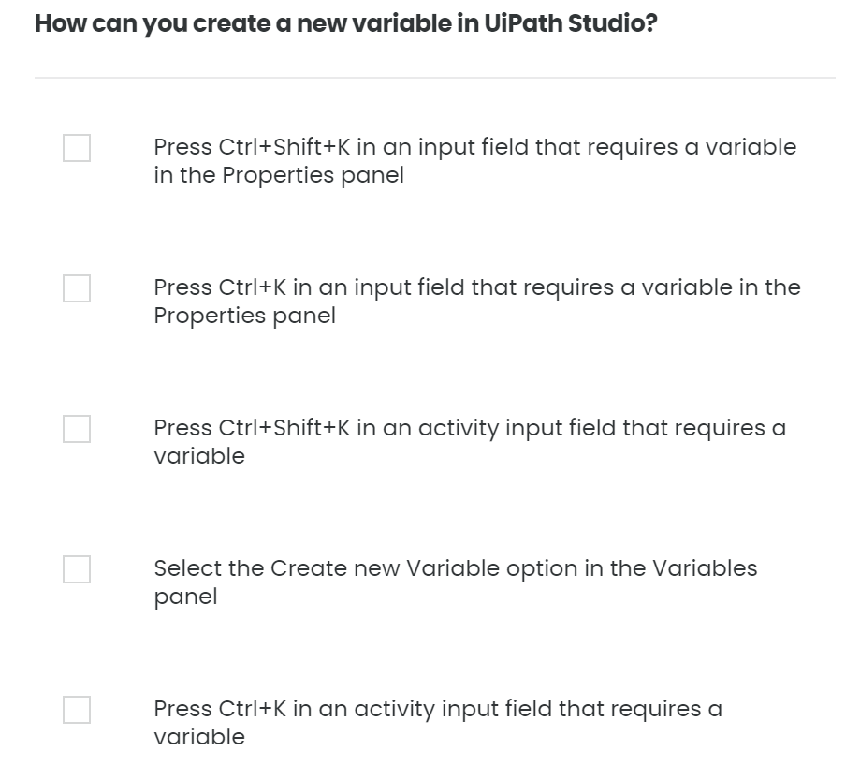
Quiz – 02/10

Slide 3
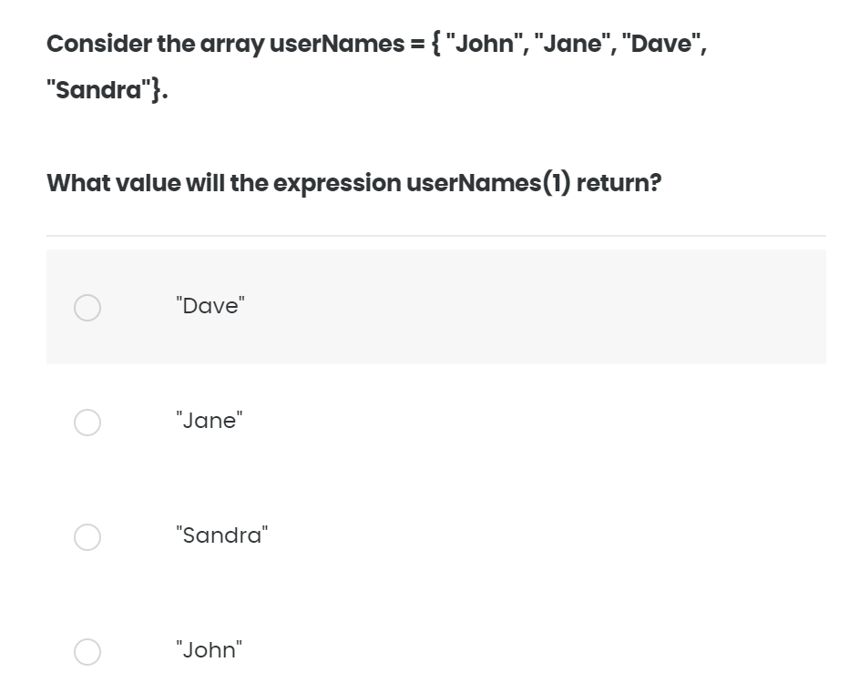
Quiz – 03/10

Slide 4
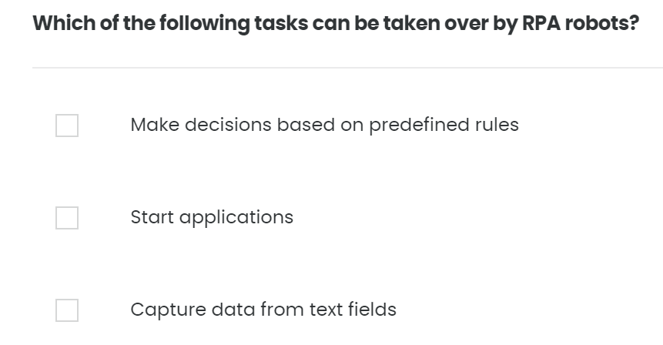
Quiz – 04/10

Slide 5
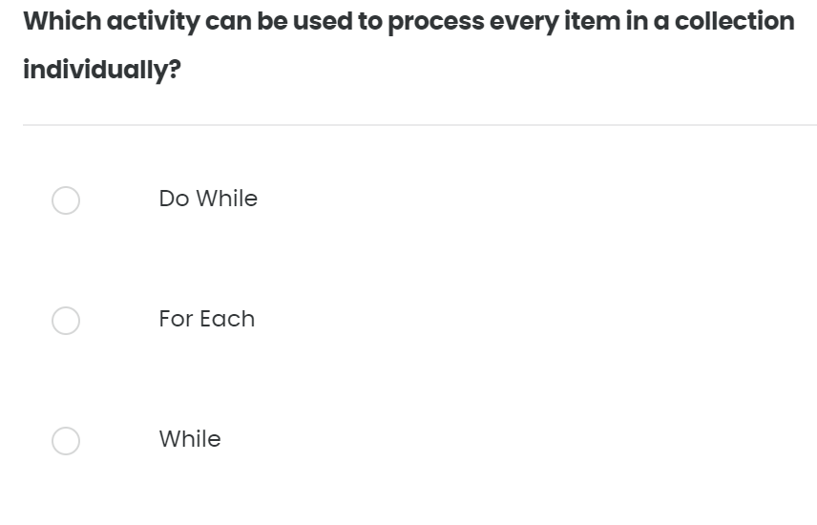
Quiz – 05/10

Slide 6
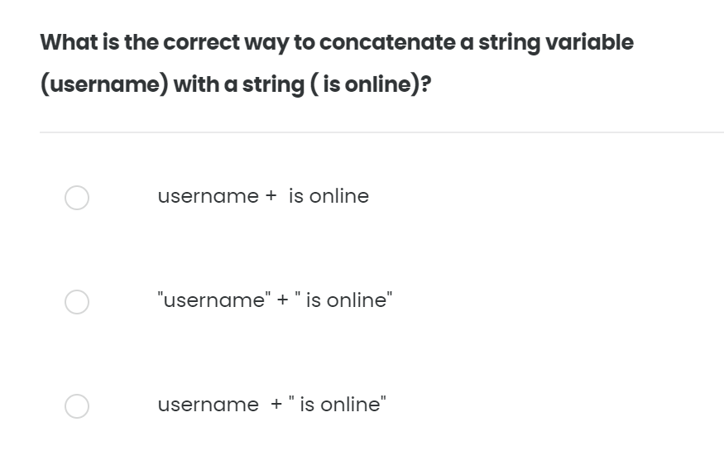
Quiz – 06/10

Slide 7
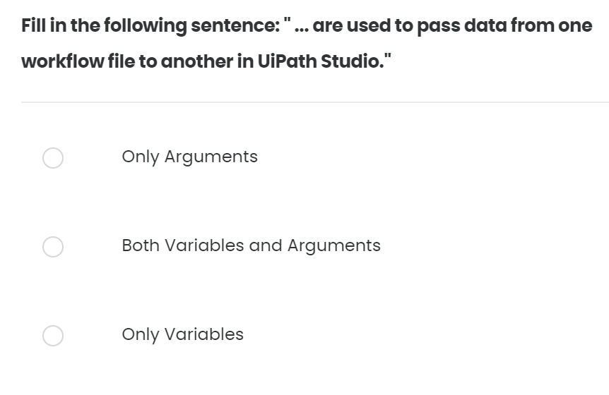
Quiz – 07/10

Slide 8
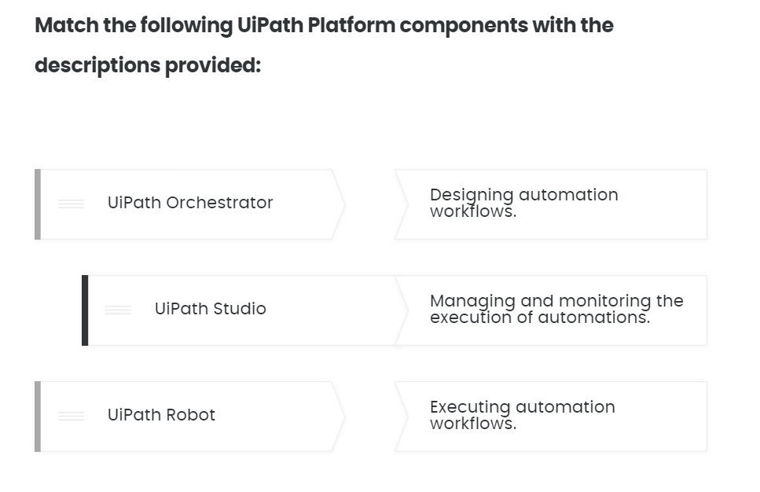
Quiz – 08/10

Slide 9
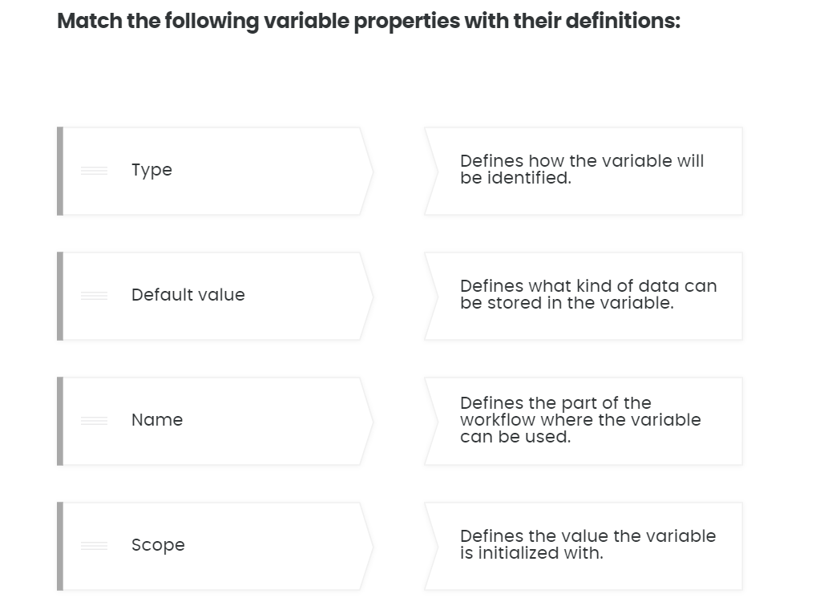
Quiz – 09/10

Slide 10
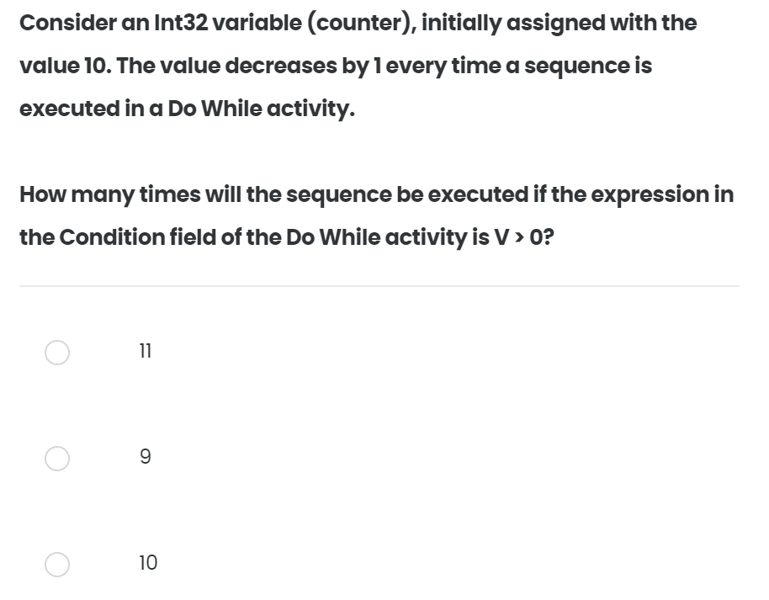
Quiz – 10/10

